Slide 1
K.R.Pete Krishna Government Engineering College K.R.Pete Mandya-571426
Name: Shweta Ninganagouda Patil
USN: 4GK21EC039
Semister: 5TH Sem
Branch: ECE
Topic:used car price prediction using multiple linear regression
Internship On
Python With Machine-learning.
At Karunadu Technologies Private Limited

Slide 2

Company Profile:
It is the pleasure to introducing “Karunadu Technologies private Limited” as a leading IT software solutions and services focus on quality standard and customer value, and also a leading Skill and talent Development Flote-form to building a manpower pool for industry requirements.
Karunadu Technologies Private Limited.
#17, ATK complex, 4th floor, acharya college main road,
Beside karurvysya bank, guttebasaveshwaranagar,
Chikkabanvara, bengaluru, karnataka- 560090
Support@karunadutechnologies.com
They deal with broad range of product development along with customized features ensuring at most customer satisfaction and also empower individual with knowledge, skills and competencies that assist them to escalate as integrated individuals with a sense of commitment and dedication.
To empower unskilled individual with knowledge, skills and technical competencies in the field of information technology and embedded engineering which assist them to individuals contributing to company’s and nation’s growth.

Slide 3
cost effective and reliable solutions to customers across various technologies.
OffProvideer scalable end-to-end application development and management solutions
Focus on creating sustainable value growth through innovative solutions and unique partnerships.
Keep our products and services updated with the latest innovations in the respective requirement and technology.
Objectives:
To develop software and Embedded solutions and services focussing on quality standards and customer values.
Offer end-to-end embedded solutions which ensure best customer satisfaction.
To build Skilled and Talented manpower pool for industry requirements.
To develop software and embedded products which are globally recognized.
To become a global leader in Offering Scalable and cost-effective Software solutions and services across various domains like E-commerce, Banking, Finance, Healthcare and much more.
To generate employment for skilled and highly talented youth of our Country INDIA.

Slide 4
Topics learnt during-internship:
Python:
1.Features of Python.
2.Python libraries (Numpy , Pandas and Matplotlib)
Machine Learning and Algorithms.
3.Linear Regression
4.Multiple Linear Regression.
5.Logistic Regression.
6.KNN
7.SVM
8.Decision Tree.
9.Random Forest.
Open CV.

Slide 5

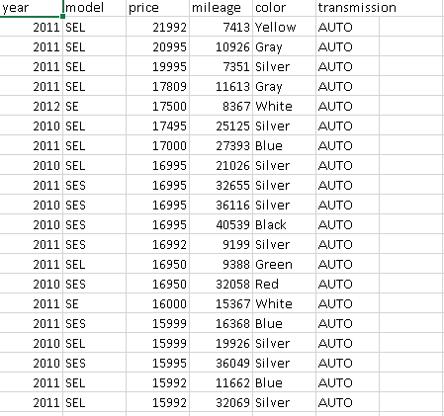
USED CAR PRICE PREDICTION:
DataSet used for Project:

Slide 6
Problem Statement:
Develop a model that has the capacity of predicting Used Car Price by making use of the information provided in Used Car Price Dataset…
Algorithm-MULTIPLE LINEAR REGRESSION::
It is a very simple Python program to implement.
Multiple Regression is like Linear Regression , but with morethan one independent value , meaning that we try to predict a value based on two or more variables.
Multiple Linear Regression is implemented using the linear Regression class from sklearn . Linear _ model library.

Slide 7
Advantages And disadvantages:
Advantages:
The ability to determine the relative influence of one or more predictor variables to the criterion value.
The ability to identify outliers , or anomalies.
Disadvantages:
Any disadvantage of using a multiple regression model usually comes down to the data being used . Two examples of this are using incomplete data and falsely concluding that a correlation is causation.

Slide 8
INPUTS & OUTPUTS DECLARATION:
INPUTS:
YEAR
MODEL
COLOR
MILLEAGE
TRANSMISSION
OUTPUT:
PRICE.

Slide 9
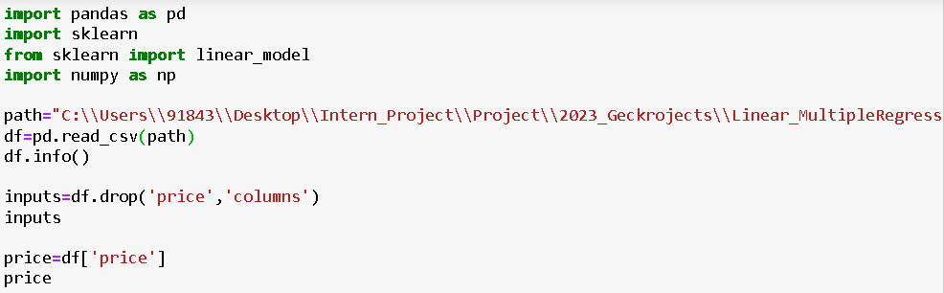
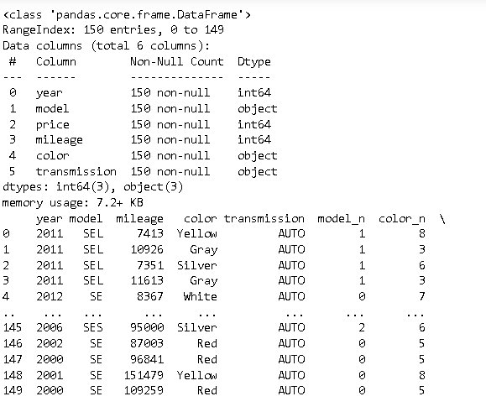
Programing Steps:
This project requires us to predict the USED CAR PRICE based on the given input dataset.
First, we read the given dataset using pandas function.
Code:
Output:

Slide 10
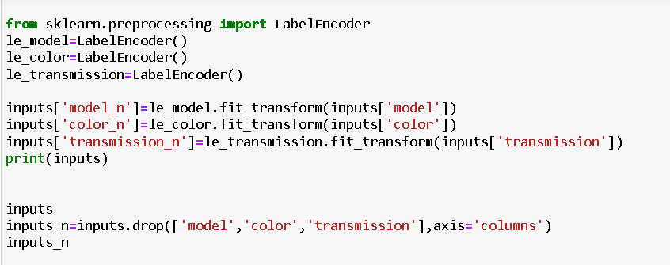
Then we need to convert Non-Numeric to Numeric.
Code:

Slide 11
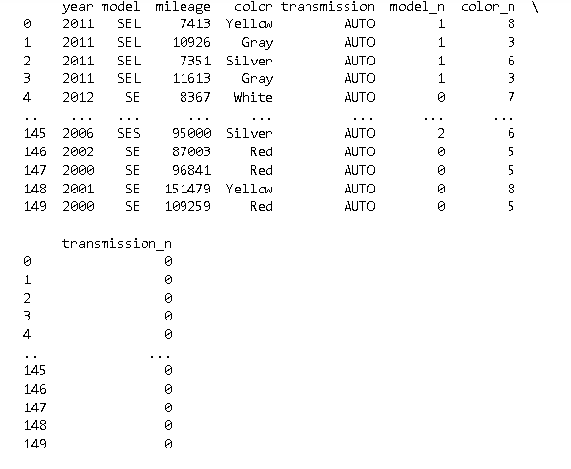
Output:

Slide 12
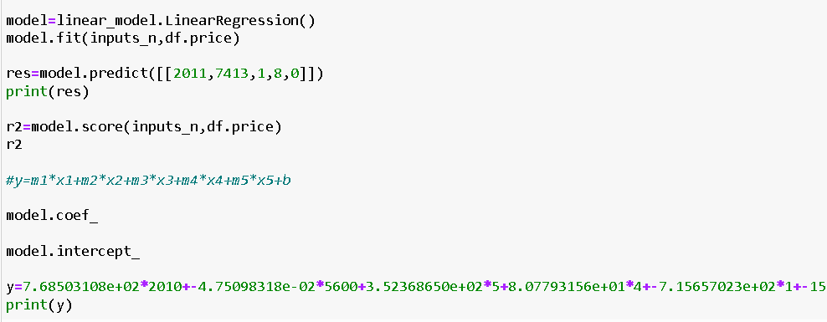
To Print The Result.
Code:

Slide 13
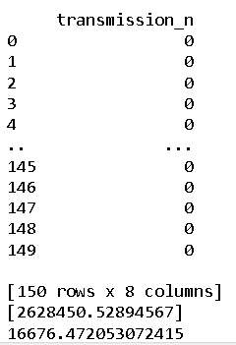
Output:

Slide 14
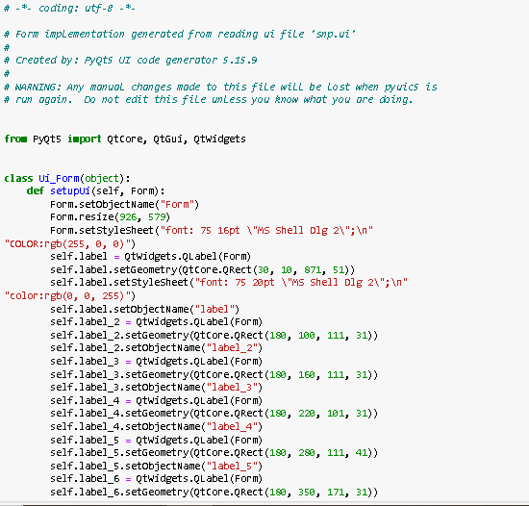
We further implement this using PyQt in order for better representation.
Code:

Slide 15
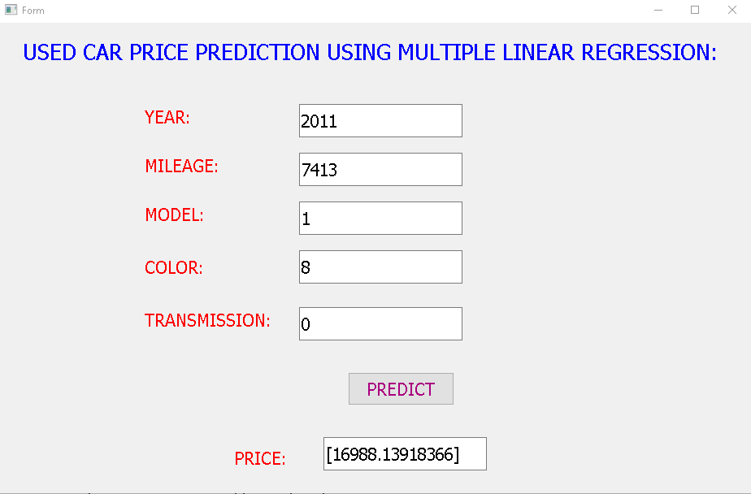
Output:

Slide 16
Conclusion:
The Internship aims to use python programming language for Machine learning so as to apply the theoretical knowledge to solve real time and complex problems.The Internship helped to find appropriate prediction model to the problems by applying suitable learning algorithm which can be used in future.The internship project assigned by the company helped to improve programming skills and to implement basic knowledge for solving real world problem. In this project Multiple Linear Regression is used to predict the Price.After having a basic understanding of Supervised learning,we explored the Multiple Linear Regression algorithm which is used to solve machine learning problem. The Price varies based on the inputs given in the used car price dataset.

Slide 17
Thank You.

